Slide 1
Picture Detectives

Slide 2
The Big Question Is…

Slide 3
What is “fair”?

Slide 4
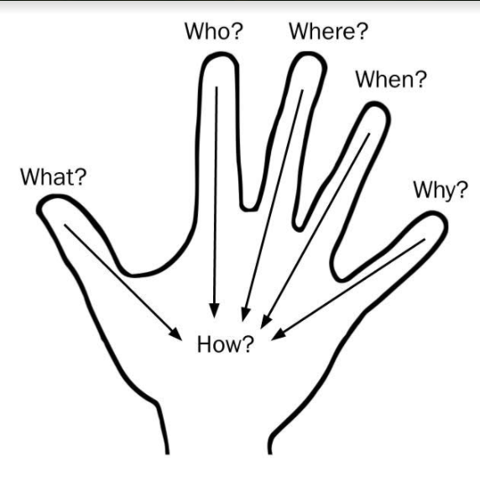
When you are looking at these pictures, I want you to be a “picture detective” by asking….

Slide 5
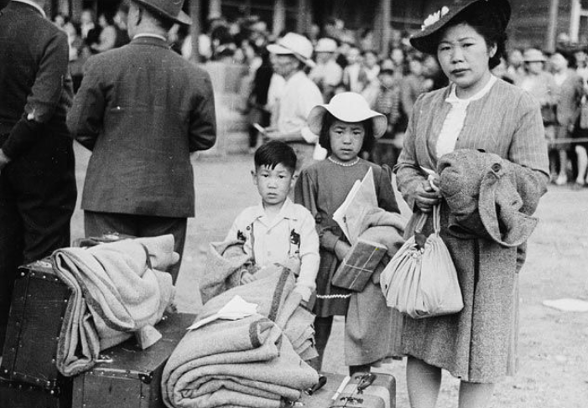

Slide 6
Who? A family: a boy, a girl and a mom (dad?).

Slide 7
When? 1942.

Slide 8
Where? Hastings Park (PNE).

Slide 9
What? They are going to internment.

Slide 10
Why? Because their family is of Japanese descent.

Slide 11
How? The government sent them to an internment camp.

Slide 12
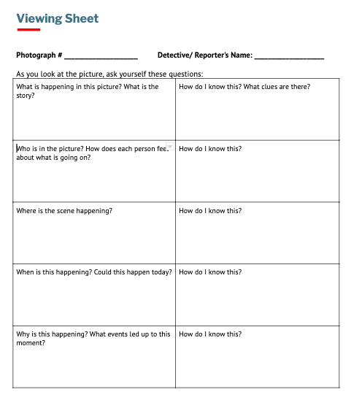

Slide 13
Before the War?

Slide 14
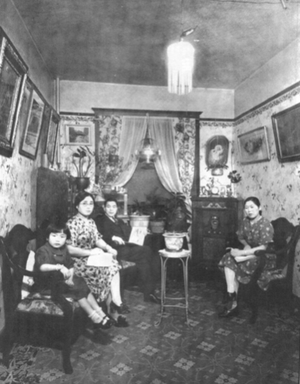

Slide 15
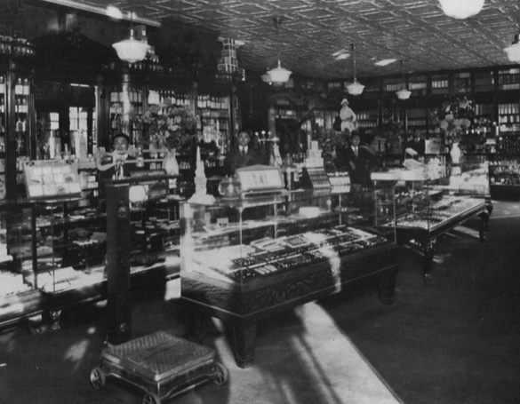

Slide 16
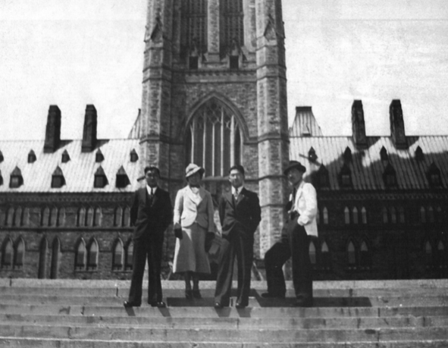

Slide 17
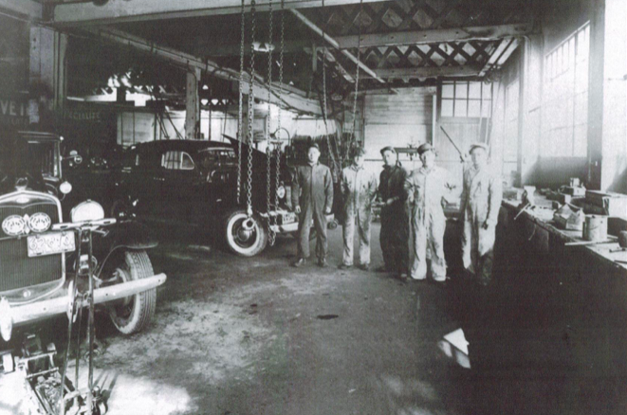

Slide 18
After Pearl Harbor

Slide 19
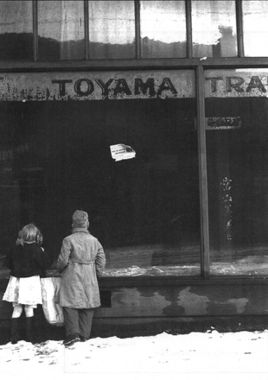

Slide 20
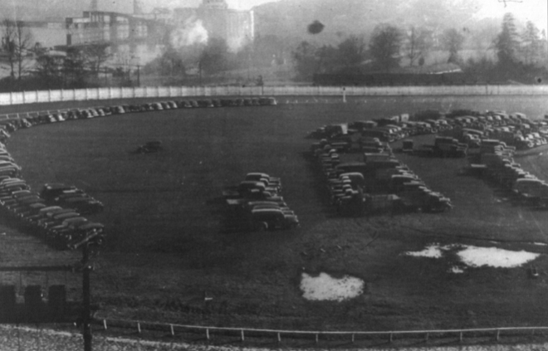

Slide 21
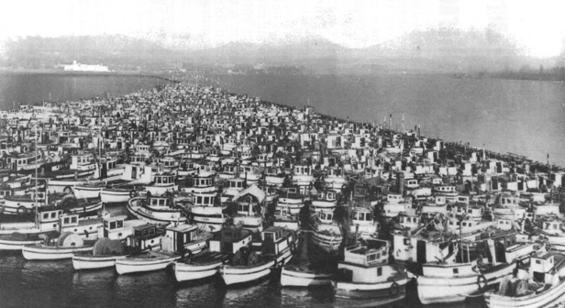

Slide 22
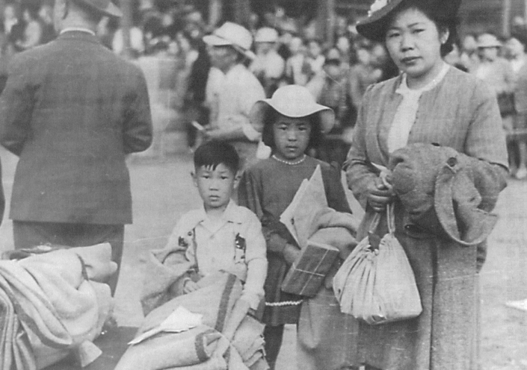

Slide 23
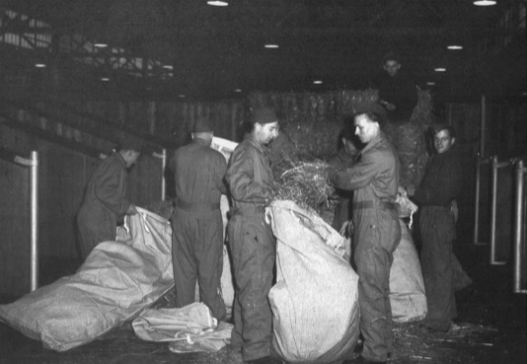

Slide 24
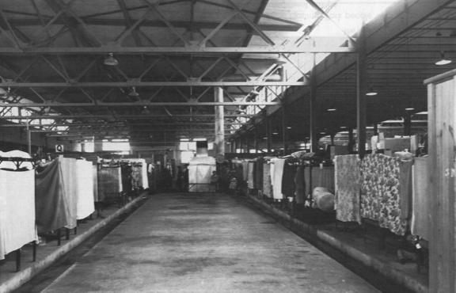

Slide 25
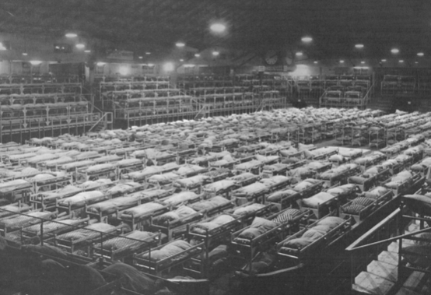

Slide 26
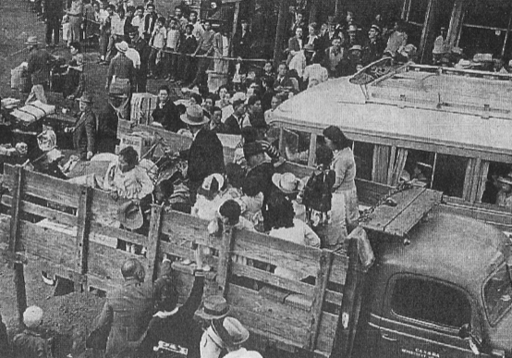

Slide 27
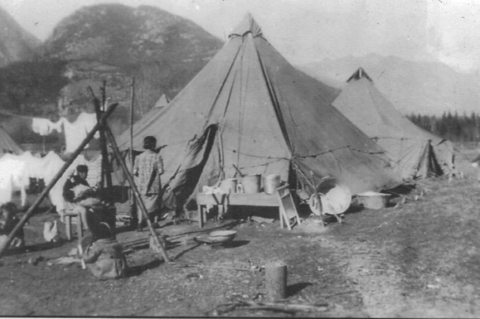

Slide 28
