Slide 1
POWELL STREET SIMULATION OVERVIEW
Part 1:
This is the PowerPoint I showed a class so they could help me come up with samples for the Powell Street simulation.
Part 2:
This next part show samples of what they came up with in the simulations.

Slide 2
PART 1
This is the PowerPoint I showed a class so they could help me come up with samples for the Powell Street simulation.

Slide 3
NEW PROJECT

Slide 4
I NEED YOU TO HELP ME WITH A SPECIAL PROJECT.
This work will be seen by teachers, students, and universities across Canada!

Slide 5
YOUR JOB IS TO RECREATE AN IMMIGRANT NEIGHBOURHOOD.
You will be making bulletin boards of an interactive virtual map of 1940s Powell Street in Vancouver.

Slide 6
Each of you will "adopt“ a Japanese Canadian family, recreate their business and home, and place that property on the bulletin board map in our classroom.

Slide 8
YOU, GRADE 4 AND 5S, WILL BE MAKING A DISPLAY OF AN IMMIGRANT, CITY COMMUNITY 70 YEARS AGO.
It does not look like much now…

Slide 9
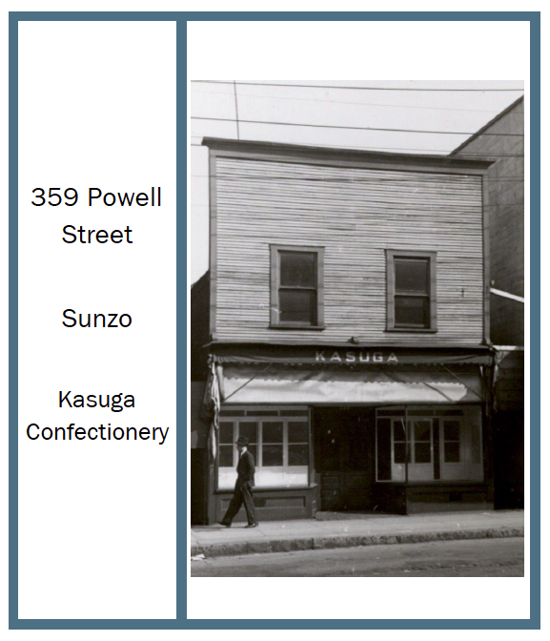
YOU WILL BE GIVEN A PROPERTY CARD.
It will include:
a picture of your property.
the address (so you will know where to put it on the map).
the name of the family who owned it.
the kind of business it was.

Slide 11
INDIVIDUALLY, EACH OF YOU WILL CREATE A BUSINESS DOWN BELOW WITH A PLACE TO LIVE (AN APARTMENT) UP TOP.
Each of you will use 2 cards.
One for the business below and one for the residence up top.
Each card will be folded so that the outside of the card is the outside of the building, and the inside of the card is the inside of the building.

Slide 12
A FEW THINGS TO REMEMBER...
Make the rooms only (no people and no possessions yet).
Make the cards fit:
the times: 70 years ago, there was electricity, but no computers, etc.
the businesses: a counter and shelves for stores, etc.

Slide 13
HERE IS WHAT ONE OF THE PROPERTIES LOOKED LIKE IN 1925 AND IN 2016.

Slide 14
1940S AND 2016 (NOTICE HOW THE NEIGHBOURHOOD HAS CHANGED).
Click the picture to see the web link.
→

Slide 15
HERE ARE SOME MORE PICTURES TO SHOW YOU WHAT VANCOUVER WAS LIKE BACK THEN.

Slide 17
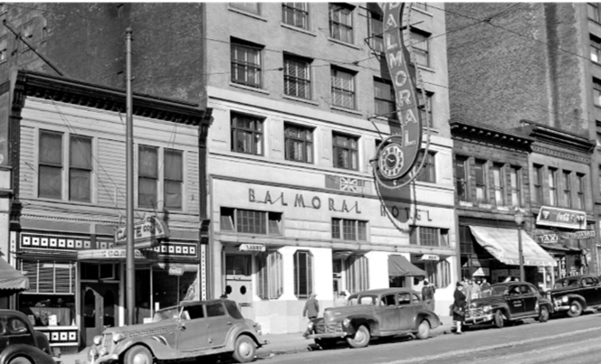

Slide 19
END.
Show Property Cards and take questions.

Slide 20
PART 2
This next part show samples of what they came up with in the simulations.

Slide 21
LINDSAY’S POWELL STREET SIMULATION

Slide 22
MY SCHOOL: EXAMPLES OF POSSESSIONS, PEOPLE, AND PROPERTY CARD

Slide 23
THEY USED THESE TO POPULATE THEIR HOMES AND BUSINESSES.

Slide 24
LINDSAY: EXTERIOR

Slide 25
LINDSAY: EXTERIOR

Slide 26
LINDSAY: INTERIOR

Slide 27
LINDSAY: SAMPLES TAKEN OFF THE BULLETIN BOARD

Slide 28
THE STUDENTS DID AN INCREDIBLE JOB INCLUDING DETAIL AND REALISM.

Slide 29
PEARL HARBOUR AND BEGINNING OF INCARCERATION AND FORCED REMOVAL
“People” were moved to camps on a separate bulletin board.
Materials slowly disappeared from Powell Street bulletin board.

Slide 30
LINDSAY: INTERNMENT CAMP

Slide 31
LINDSAY REPORTS THAT THEY STUDENTS WERE REALLY UPSET WHEN THEIR AVATARS WERE MOVED WITHOUT PERMISSION.

Slide 32
INSIDE SHACK

Slide 33
LINDSAY: PEOPLE REMOVED AND POSSESSIONS START TO DISAPPEAR AS THEY ARE SOLD TO PAY FOR INCARCERATION. LINDSAY REPORTS THAT THE STUDENTS WERE EVEN MORE UPSET BY THIS.

Slide 34
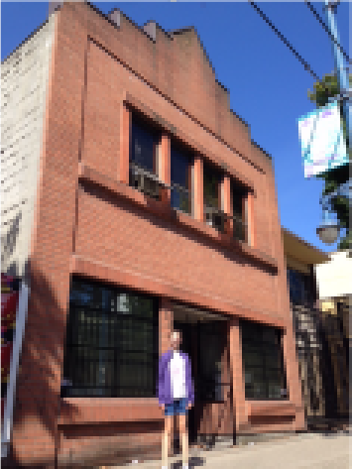
EPILOGUE ABOUT HEARTS-ON LEARNING:
Showing how attached she was to her learning, this student talked her parents into taking a picture of her, in front of her building (the one she learned about in class).

