Slide 1
REDRESS

Slide 2
The Big Question is…

Slide 3
How do you apologize after you make a mistake?
What is the right kind of apology

Slide 4
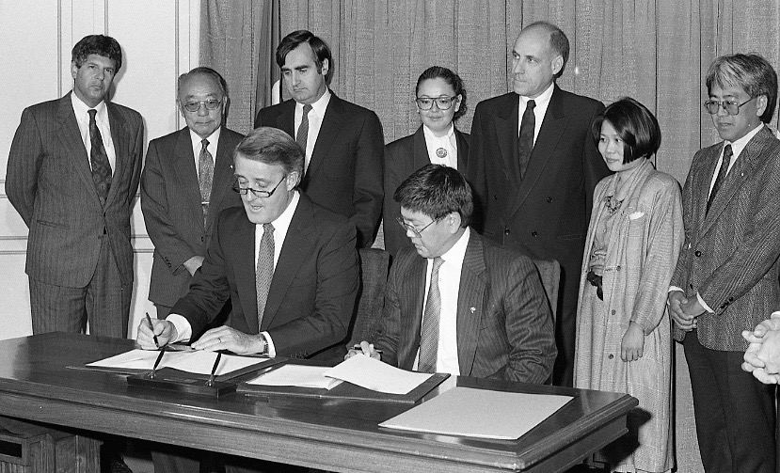
An Appropriate Apology
It took many years, but the Canadian Government realized they made a mistake
Today, you will learn how they made an apology to Japanese Canadians.
You will decide for yourself whether or not it was the right kind of apology

Slide 5
But first, your assignment...
In groups you will be given a situation
Your group will decide if an apology is necessary or not, and should be able to explain why or why not.
Your group will then put on a 1 minute skit about how you would effectively deal with this situation and be ready to share it with the whole class.

Slide 6
Now, let’s find out how the government apologized to Japanese Canadians.
But first, to review...

Slide 7
Internment
22,000 men, women and children were sent to internment camps because they were Japanese Canadians

Slide 8
Discrimination & Racism
In the Fair/Unfair game you learned: you should not be treated differently because of how you look or where you come from.

Slide 9
Racism
Canada vs. Canadians
Most Japanese Canadians who were sent to internment camps were Canadian citizens
Canadians turned on their own people because of racism

Slide 10
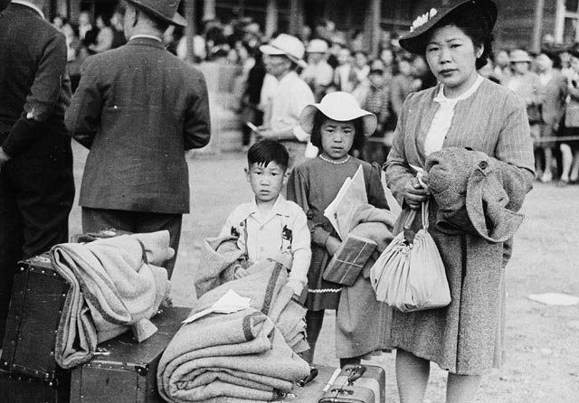
22,000 men, women and children were sent to internment camps because they were Japanese Canadians

Slide 12
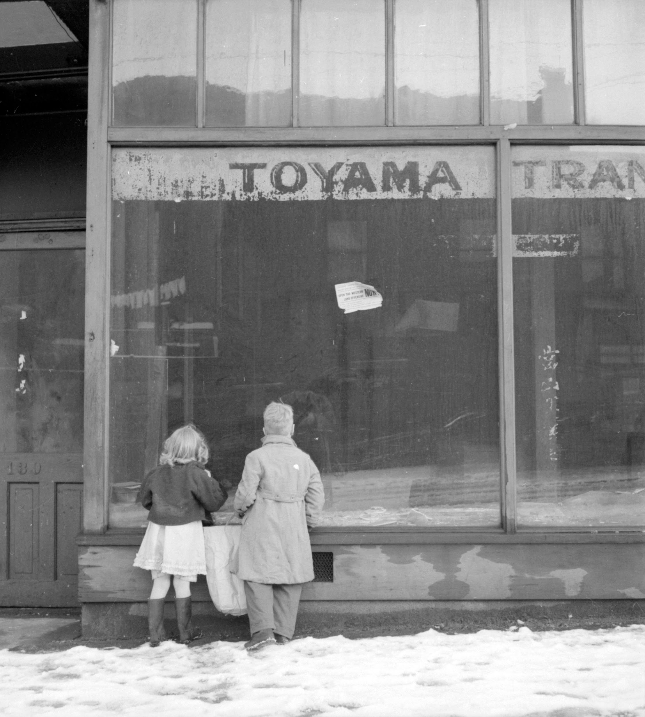

Slide 13
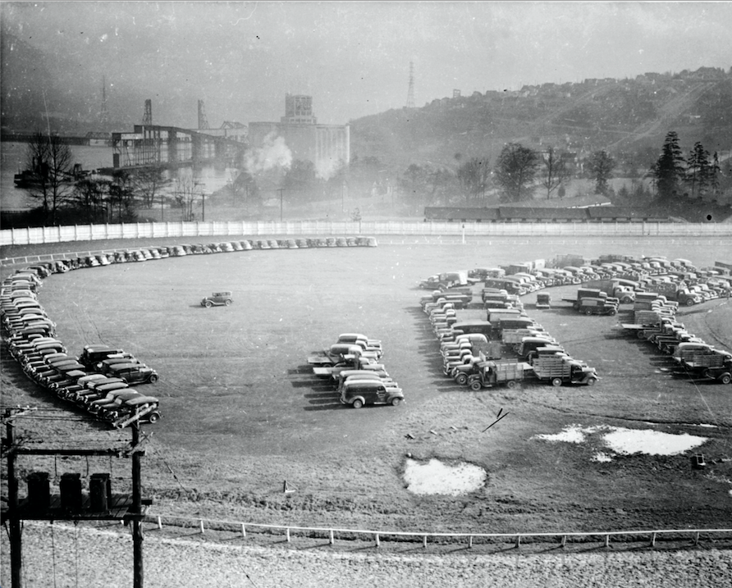

Slide 14
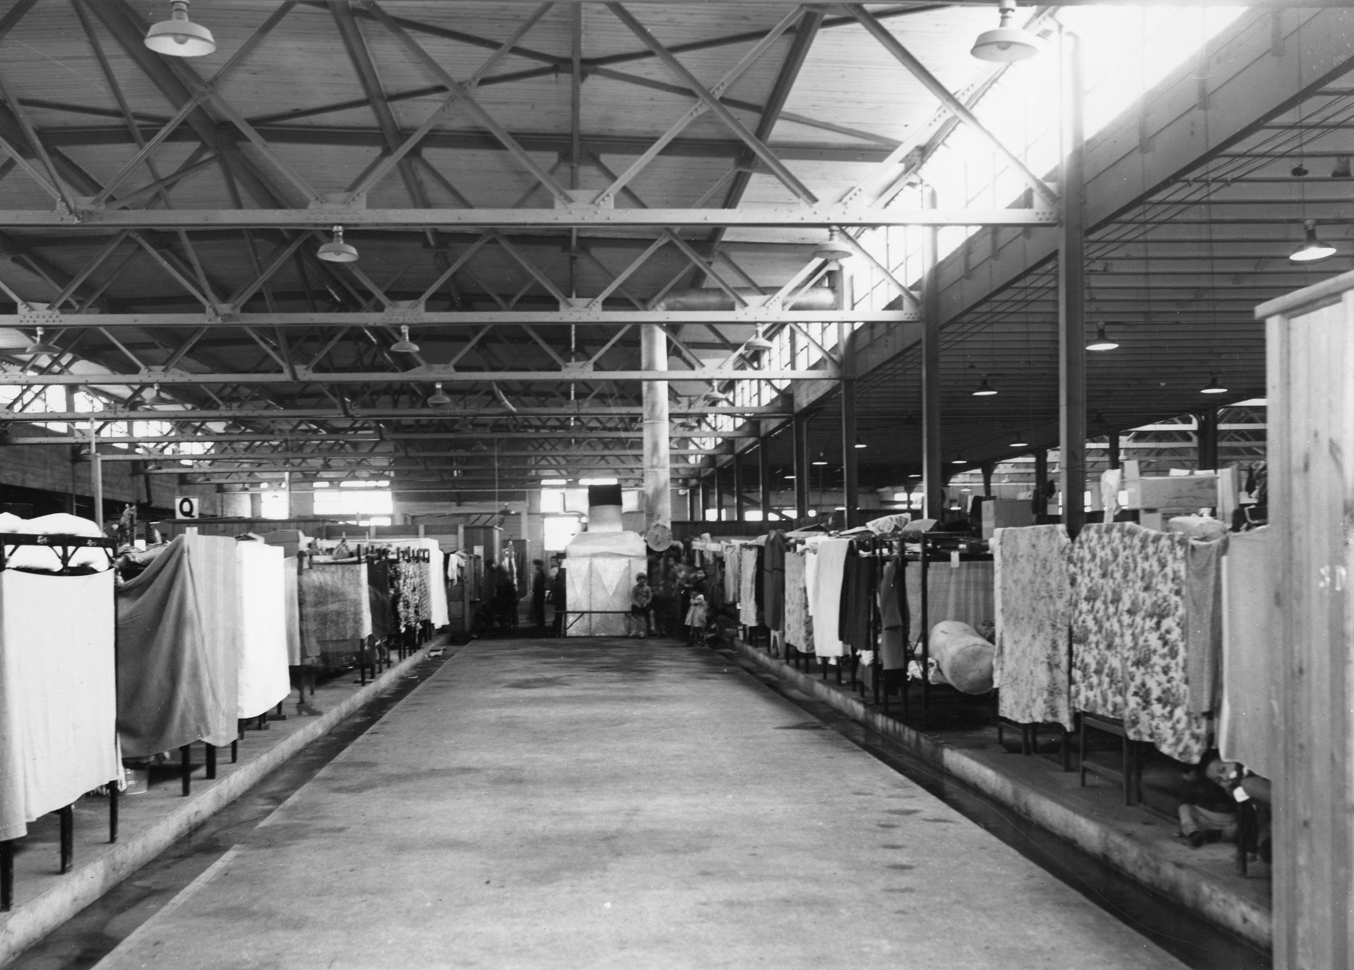

Slide 15
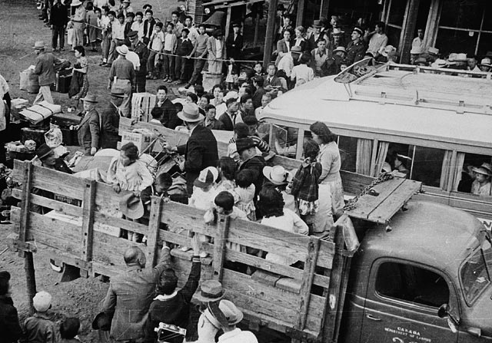

Slide 16
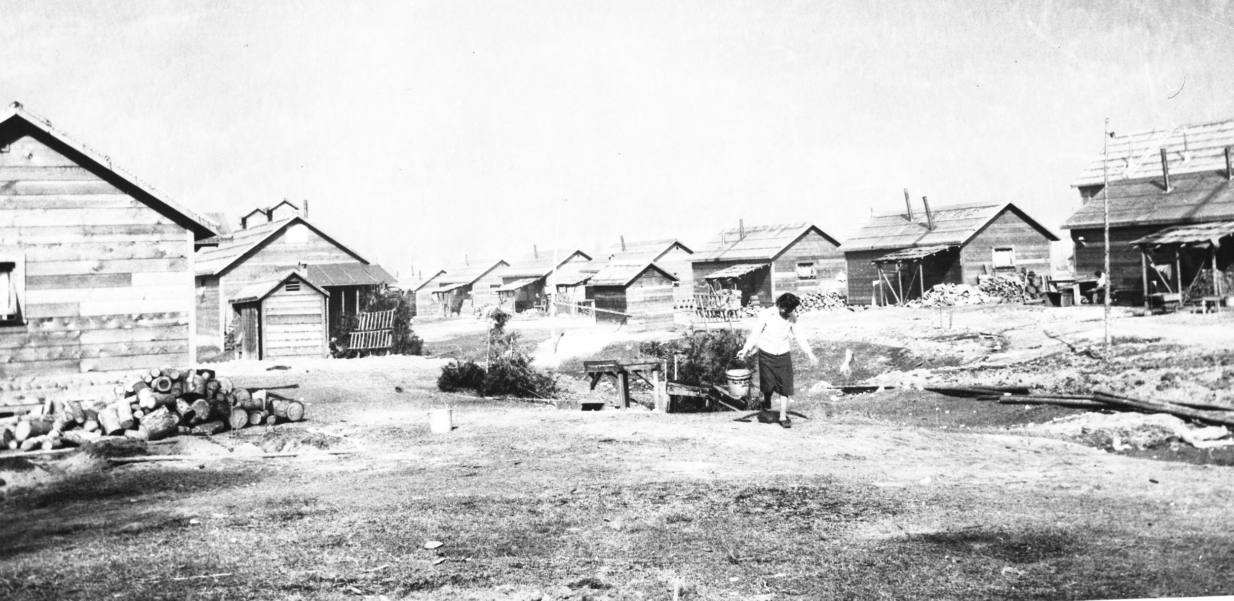

Slide 17
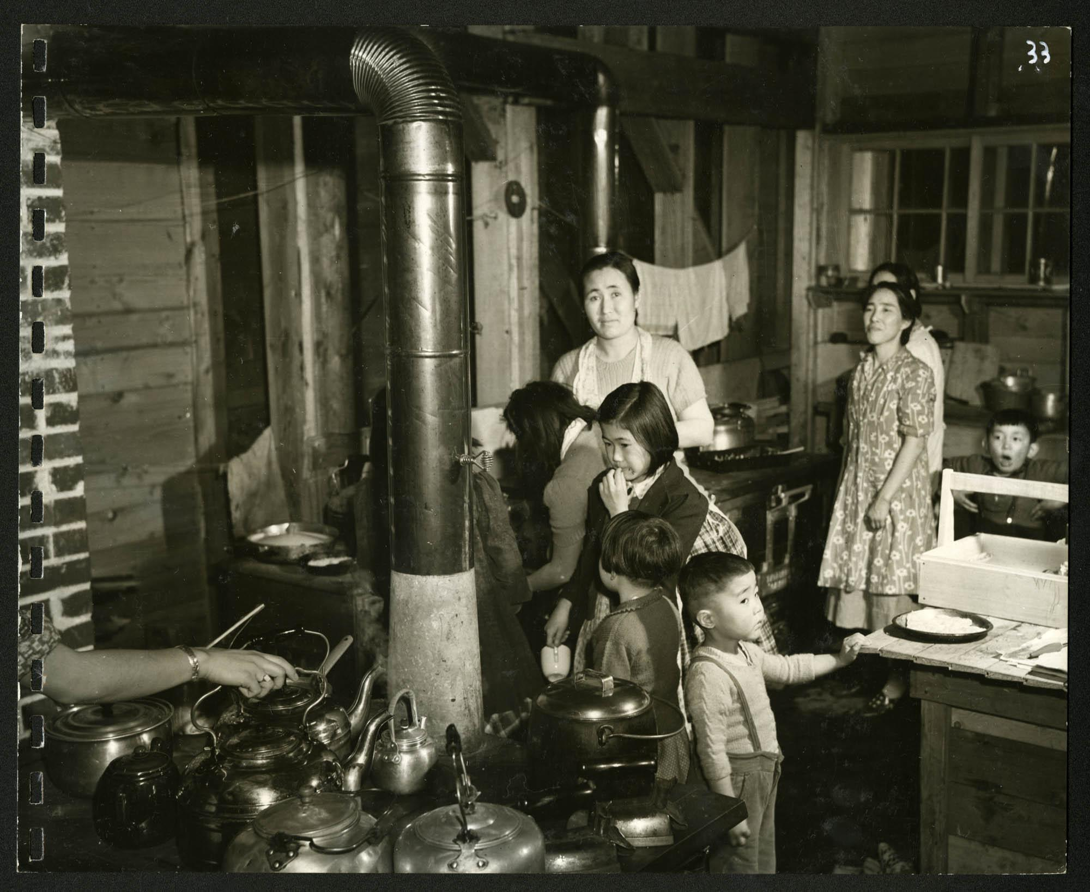

Slide 18
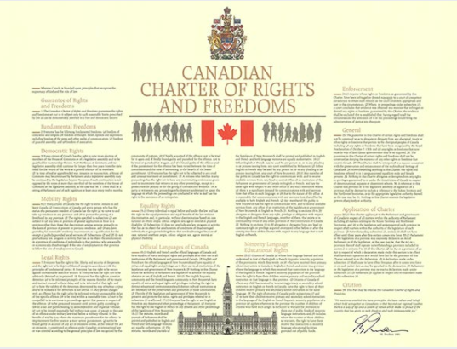
Now we have the Canadian Charter of Rights and Freedoms to protect us.

Slide 19
It did not exist during World War II.
If it did, Japanese Canadians may have been protected

Slide 20
Japanese Canadians were not allowed to move freely. They were forced out of their homes and were not allowed to be on the coast of BC.
MOBILITY RIGHTS
Even when the war ended, Japanese Canadians were given the choice, move out of BC or move “back” to Japan. Again, Japanese Canadians had to start over with almost nothing

Slide 21
Japanese Canadians were not treated fairly by the law.
They had no trial, no lawyers to defend them, and were not thought to be innocent until PROVEN guilty
Their homes, cars, property and business were sold without permission.
The money was used by the government to pay for the Japanese Canadian’s own stay in the prison camps
LEGAL RIGHTS

Slide 22
Japanese Canadians were not treated the same as all Canadians.
They were imprisoned because their families were from Japan.
Italian Canadians and German Canadians were not treated the same way either.
EQUALITY RIGHTS

Slide 23
How did the Canadian Government Apologize?
In 1988
PM Brian Mulroney, in Parliament and on national TV, apologized to Japanese Canadians for their treatment during WWII.
Admitted Canada made a mistake.
Promised it would never happen again.
Awarded each surviving Japanese Canadian $21,000

Slide 24
What do you think…
… was it the right kind of apology?

Slide 25
The apology was symbolic.
Most Japanese Canadians were satisfied.

