Slide 1
Suitcases

Slide 2
Suitcases
When you go on a trip, you pack the things you think you’ll need: clothes, grooming items, camera, etc.
Usually you are going because you want to go and you know how long it will be

Slide 3
The Big Question is….
What do you value?
What is important to you life, to your comfort or to your survival?

Slide 4
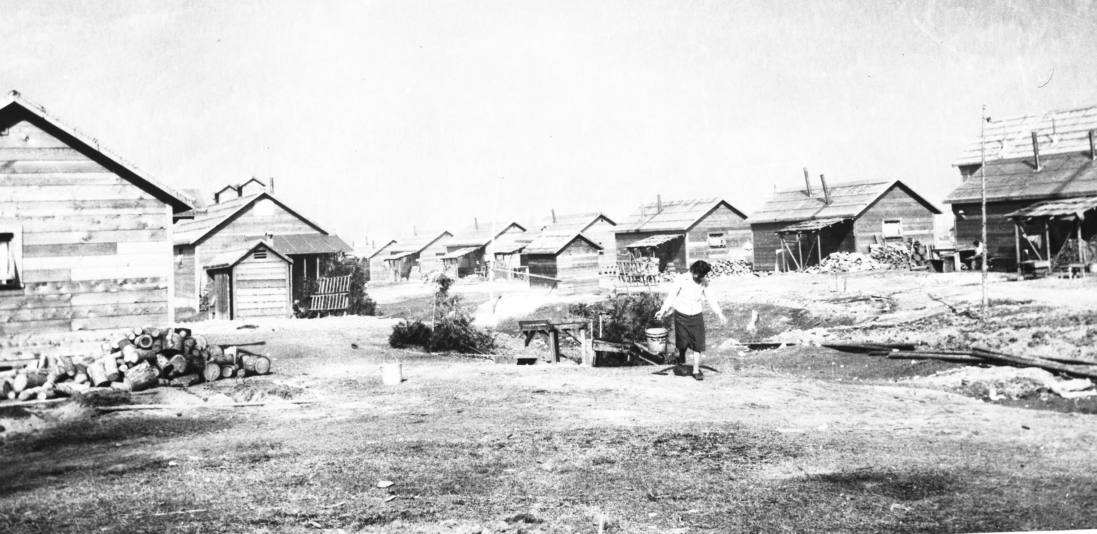
Internment
21,000 men, women and children were sent to internment camps because they were Japanese Canadians

Slide 5
Discrimination & Racism
From the Fair/Unfair fame, you learned:
No one tells you the rules, so you have to figure it out for yourself as you go.
You are treated differently because of how you look (even though you have choice or control of it), and NOT because of who you are and what you do.

Slide 6
The Difference Between War & Racism
War:
Canada vs. Japan
Racism:
Canada vs. Canadians
most of the Japanese Canadians who were sent to internment camps were Canadian citizens
Canada turned on their own people because of racism

Slide 7
Now, we have the Canadian Charter of Rights and Freedoms to protect us from racism and discrimination

Slide 8
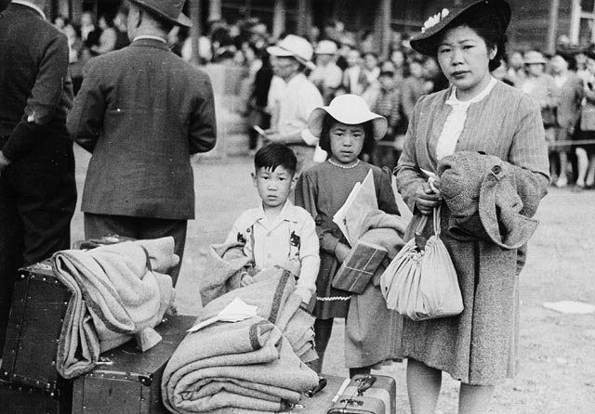
21,000 men, women and children were sent to internment camps because they were Japanese Canadians

Slide 9
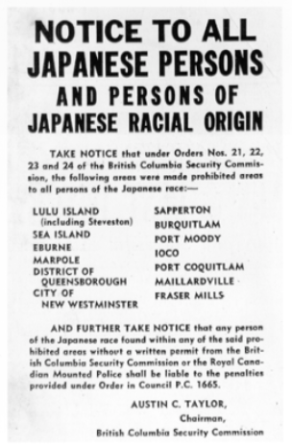
21,000 men, women and children were sent to prison camps because they were Japanese Canadians

Slide 10
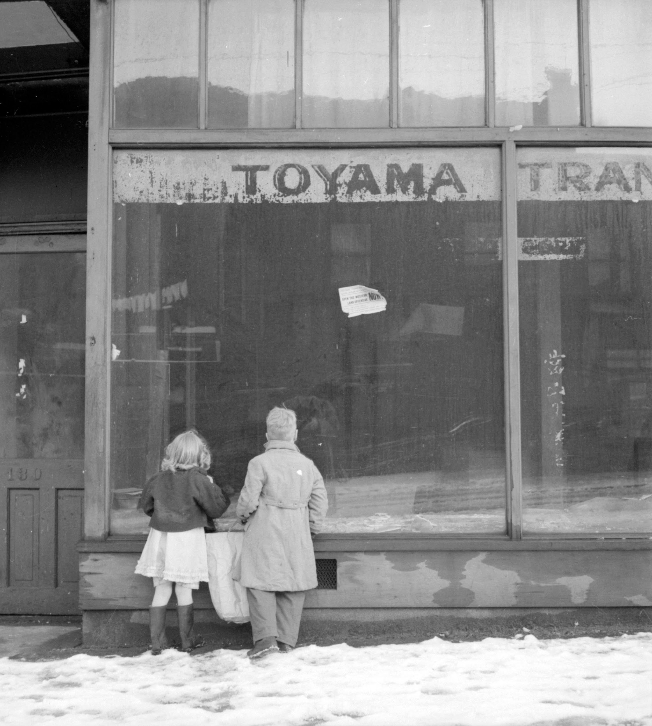

Slide 12
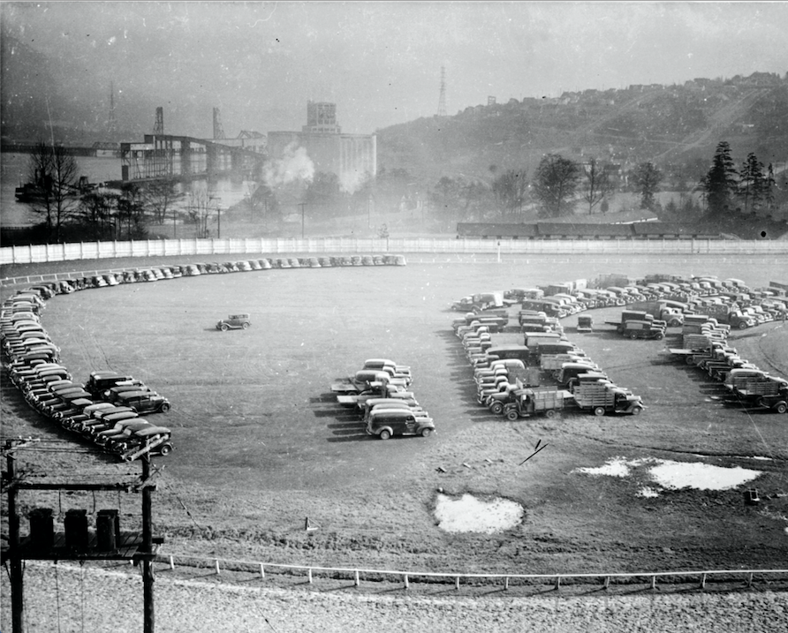

Slide 13
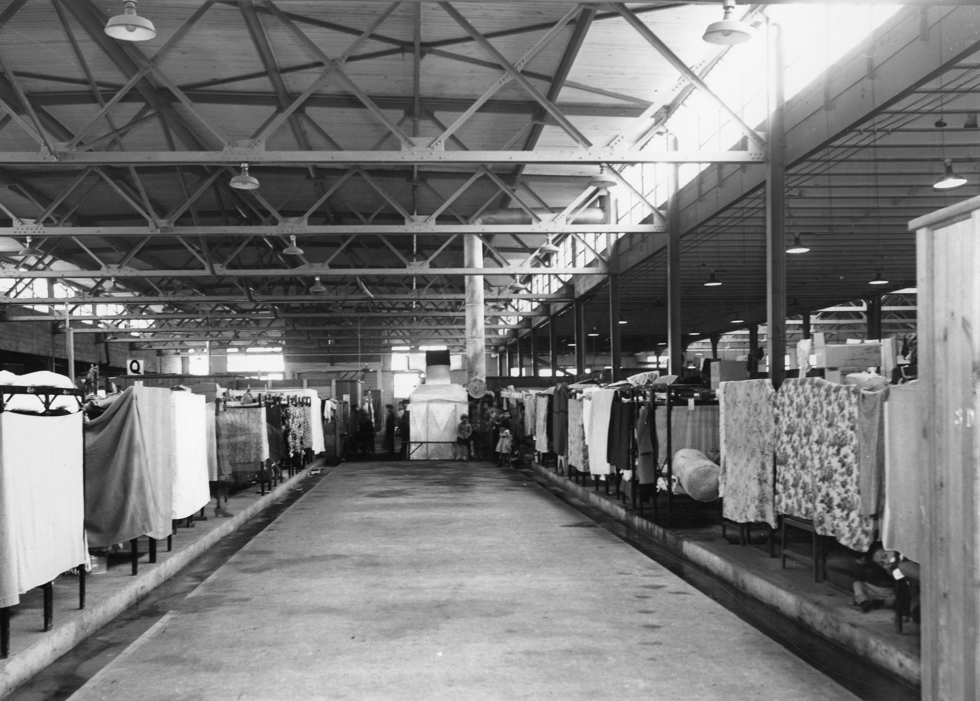

Slide 14
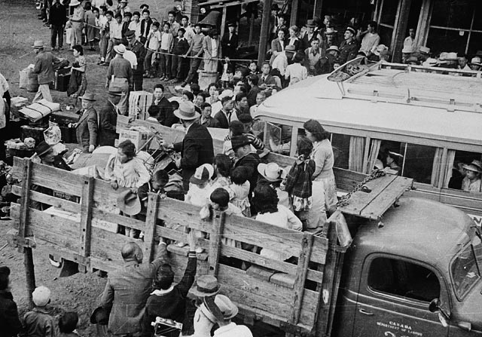
During WWII, despite being Canadian citizens, Japanese Canadians were forced out of their homes, they did not know how long it would be and they had not really heard of the places where they were sent.

Slide 15
Assignment Instructions
Remember:
There were no TVs, personal computers, cell phones, or tablets back then. Radios, cameras and recording devices were confiscated (taken away from them)
You do not know how long you are going
You could be sent to the interior of BC or the prairies.
In teams, you will be given a random character, (a young boy, an old woman, etc.).
You will work together to figure out what that person would bring to internment (a prison camp).
They were allowed to bring one suitcase, and they had to be able to carry it.

